Slide 1
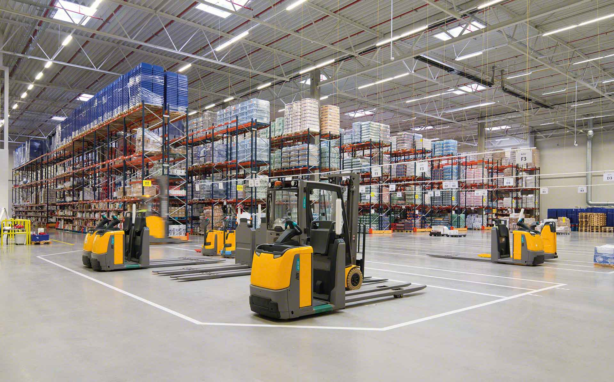

Material Handling KPI
Semana 41 octubre 2022

Slide 2
Movements October
week movements
885
Monthly movements
2089
Row Labels | Sum of CYCLE COUNTS | Sum of MAT HANDLE
erojas | 0 | 267
judelato | 1 | 218
amiranda | 1 | 160
jtobias | 7 | 147
jodelacr | 2 | 82
Grand Total | 11 | 874
User | Sum of CYCLE COUNTS | Sum of MAT HANDLE | Sum of cc MH
erojas | 1 | 619 | 620
amiranda | 1 | 496 | 497
jtobias | 9 | 361 | 370
judelato | 2 | 361 | 363
jodelacr | 17 | 222 | 239
Grand Total | 30 | 2059 | 2089

Slide 3
Adjustments
Adjustments difference
$5069.1
Row Labels | Sum of COST
amiranda | -122.2
jodelacr | 246.33
jtobias | 4698.73
judelato | 246.24
Grand Total | 5069.1

Slide 4
Labor intensive
Class not slotted count
18
Labor Intensive
34

Slide 5
rESTOCK
Part Numbers stocked
235

Slide 6
Empty locations
Week empty locations
275

Slide 7
Discrepancies
Row Labels | Sum of Locaciones
29 Agosto- 2 Septiembre | 25
5 - 9 Septiembre | 15
12- 16 Septiembre | 15
26-30 Septiembre | 13
19-23 Septiembre | 10
3-7 Octubre | 5
10-1 octubre | 0
Grand Total | 83
Total week discrepancies
0

Slide 8
Consolidation
Row Labels | Sum of 6-Oct | Sum of 13-Oct
0233649 | 8 | 6
111024794 | 7 | 6
12313 | 9 | 9
12367 | 7 | 6
13057 | 7 | 7
13219 | 7 | 6
32447 | 7 | 6
33082 | 8 | 7
36109 | 7 | 5
36306 | 6 | 4
36310 | 6 | 6
50978 | 6 | 4
62477 | 7 | 3
63129 | 6 | 5
8800091 | 6 | 5
8800107 | 7 | 4
920267097 | 6 | 4
920281547 | 6 | 6
922833838 | 7 | 6
95110 | 6 | 5
Grand Total | 136 | 110
Total week consolidations
26

Slide 9
Distribution warehouse
Item Class | Count of Item
01 - FASTENERS | 1473
10 - SAFETY SUPPLIES | 561
02 - TOOLS AND ACCESSORIES | 143
04 - HYDRAULICS AND PNEUMATICS | 116
06 - JANITORIAL SUPPLIES | 92
03 - CUTTING TOOLS | 81
50 - CLEARANCE | 73
15 - MFG Standards | 69
07 - ELECTRICAL SUPPLIES | 64
08 - Welding & Abrasives | 42
05 - MATERIAL HANDLING | 41
16 - Office Products | 35
95 - FASTENAL WORK WEAR | 23
97 - GENERAL SUPPLIES | 22
90 - PACKAGING MATERIAL | 13
99 - FASTENERS - SEMI-STANDARDS | 7
30 - SERVICE BANDSAW WELDING | 3
09 - MFG SPECIALS DIVISION | 3
33 - SERVICE REGRIND SHARPCUT | 2
14 - METALS-ALLOYS AND MATERIALS | 2
Grand Total | 2865

